Slide 1
Overview of BioLUC Data
Ethan Warner
Biofuels Land Use Change Modeling Workshop
Oak Ridge National Laboratory
May 7th, 2013

Slide 2
Overview of BioLUC Data
Primary Data Sources
Data Resolution
Data Processing for Model Use
Comparison and Contrast w/ GTAP

Slide 3
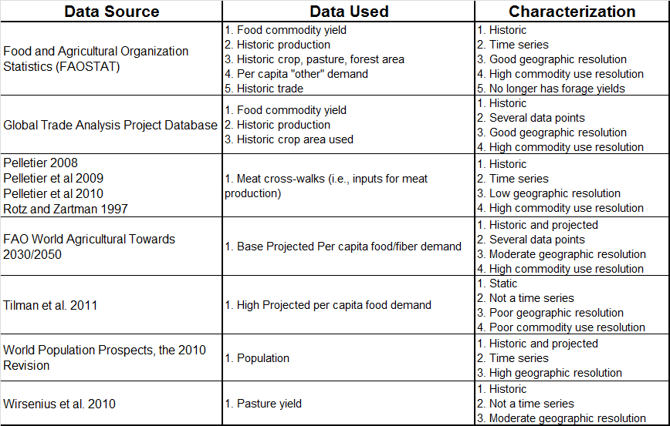
Data Sources
High Food Demand Scenarios
High/Low Pop. Scenarios
Notes:
Green – Important data inputs
Orange – Less important inputs
Red – Highlighted weaknesses

Slide 4
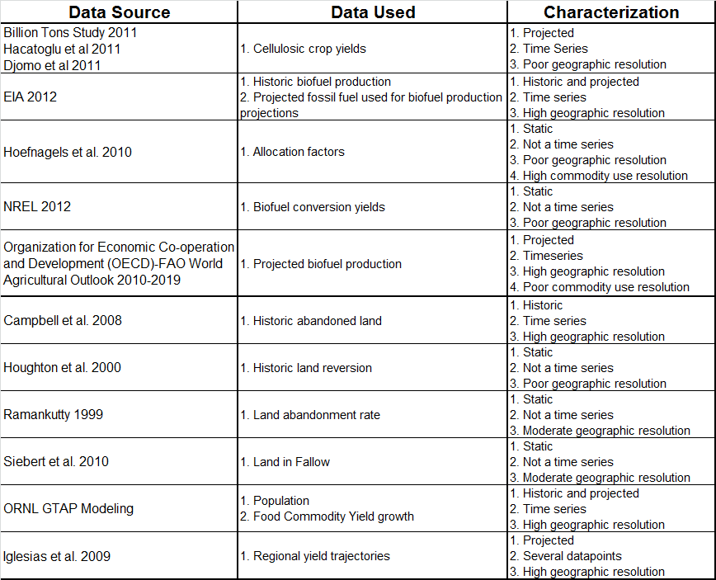
Data Sources Cont.
Multiple Alternative Biofuel Demand Scenarios
GTAP and High Yield
Scenarios
Climate Change
Scenario

Slide 5
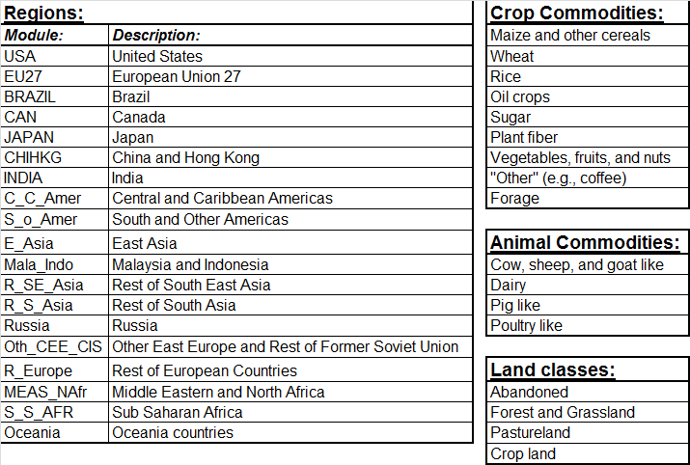
BioLUC Model Input Resolution
Notes:
19 regions:
- The model us modular so the model can be modified to more or fewer region.
19 regions is the highest resolution spatial data that we use.
Commodity Crops:
-While the items circled use land, they are not major drivers of
-They are included mostly for accounting purposes
Animal Commodities:
-Inputs for these meat products are not largely dissimilar so these could theoretically be merged.
Land Classes:
-Relative to other land classes, abandoned land is small in quantity. This category functions more as a leakage category for cropland.
-Cropland is a general category and then a category divided out into the crop category classes.

Slide 6
Data Processing
Data Source Processing Data Merging Processing BioLUC Input
FAO Per capita “other” demand
Aggregation - Country
Per capita commodity demands
Forecasting
Per capita commodity demands
Projected per capita food and fiber demand
Regional Proxies
No Change
Historic biofuel production
Projected biofuel production (to 2019)
Aggregation - Country
Biofuel demand
Cellulosic crop yields
Forecasting
Biofuel demand
Biomass conversion yields
Allocation factors
Projected fossil fuel use
No Change
GTAP production
FAO food balance
Aggregation - Country
Aggregation - Commodity
Milling factors
Milling factors
FAO Crop, pasture and forestland; GTAP Cropland; and Campbell 2008 abandoned land
Land initialization
Land initialization
FAO and GTAP Commodity yield
Forecasting
Commodity yield
Commodity yields
Trade
Land reversion rate
Meat cross-walks
No Change
Trade Initialization
Land reversion rate
Meat cross-walks
Land abandonment rate
Land in fallow
Pastureland yield
Land abandonment
Land in fallow
Pastureland yield
Regional Proxies
Population
Aggregation - Country
Population

Slide 7
Major Differences Between BioLUC and GTAP Data
Exogenous vs. Endogenous
Explicit vs. Implicit Economic Data
Land Resolution
Accounting of “Other” land
Commodity resolution
Geographic resolution, same by design

Slide 8
Summary
Data Exogenous w/ internal model feedback or stock and flow accounting
Relative Data Strengths
Population scenarios
Yield scenarios (except pasture)
Baseline demand
Relative Data Weaknesses
Resolution of meat cross-walks
Alternative demand scenarios
Non-U.S. mid-to-long term biofuel assumptions
“Other” Land accounting
Abandoned crop land leakage and reversion
Fallow

Slide 9
Additional Slides

Slide 10
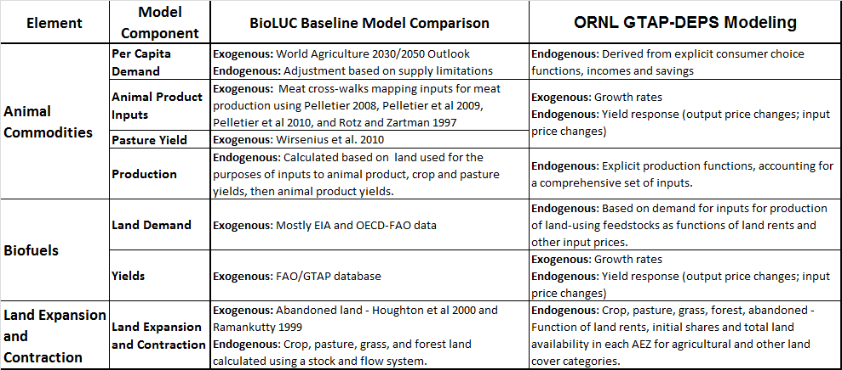
BioLUC and GTAP Data Comparison

Slide 11
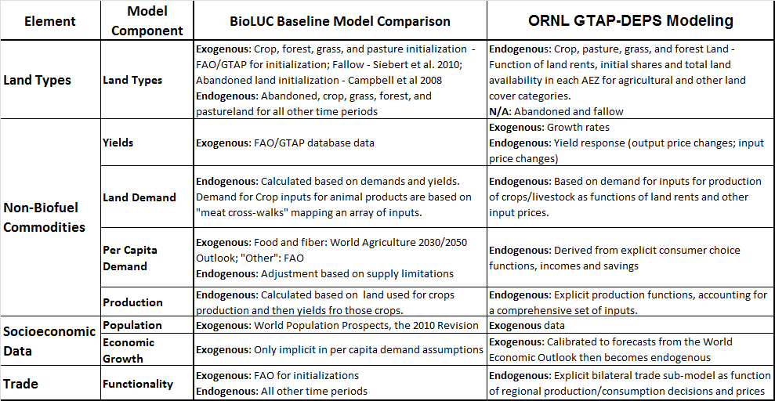
BioLUC and GTAP Data Comparison cont.

